Slide 1
BIFX 503: Statistics for Bioinformatics
Instructor: Jennifer Schroeder, Ph.D.
Wednesdays, 5:30-8:15pm
Hodson Technology Center, Room 237
Fall 2021

Slide 2
Course Introduction

Slide 3
Course Objectives
Fundamental concepts in statistics, as applied to bioinformatics
Visualize and quantify relationships between variables
Perform comparisons and statistical tests
Introductory statistical modeling and data mining
Develop fluency with the statistical analysis software R

Slide 4
Class Format
Hybrid format
Live class sessions: in person or remote
Asynchronous sessions: View material on your own
Live sessions will consist of lecture plus demonstration of how to do analyses in R
Time during class to work on homework
Live sessions will be recorded and posted on Blackboard
Attendance taken during live sessions for contact tracing

Slide 5
Required Materials
Textbook
A Handbook of Statistical Analyses Using R, 3rd edition, by Torsten Hothorn and Brian S. Everitt. CRC Press, 2014
Access to R and Blackboard
Excellent resource:https://r4ds.had.co.nz/
Covers many techniques not covered in detail in this course

Slide 6
Grading
Midterm exam: 25%
Final exam: 25%
Weekly quizzes: 25%
12 total
10 questions (true-false, multiple choice)
Homework problem sets: 25%
4 total
Data analysis and writing up results

Slide 7
Exams
Midterm exam on October 6
Covers material presented through September 29
Final exam on December 8
Covers all material, but emphasizes post-midterm
Exams are open book, open note
No use of internet or phone
Make-up exams given only for extenuating circumstances

Slide 8
Homework Sets
Four homework sets
2-3 weeks to do each
We will spend part of each class working on homework
You are encouraged to collaborate on the homework problems in groups of 2-3 students
Each student must turn in their own write-up
Submit a writeup containing your answers – analysis results, figures, tables – not computer code and output

Slide 9
Getting Help
Virtual office hours
7-8 pm on Tuesdays
Email: schroeder@hood.edu

Slide 10
Introduction to R

Slide 11
History and Overview
R is derived from S, a statistical analysis language developed at Bell Labs in the 1970s and now owned by TIBCO
The intent of S was for interactive data analysis as well as programming
R was created in the 1990s using GNU General Public License to make R free software
This allowed the source code for the entire R system to be accessible to anyone

Slide 12
Features of R
Runs on almost any standard computing platform and operating system
Open-source
Anyone is free to adapt it to whatever platform they choose
Frequent releases
Major annual release, smaller bug-fix releases
Many packages to extend functionality
Multiple ways to accomplish the same task
Active and vibrant user community

Slide 13
Design of R
The primary R system is available from CRAN (Comprehensive R Archive Network)
This is “base” R
“Base” R contains the fundamental functions
Many add-on packages extend the functionality of R, also available from CRAN
Over 4000 packages on CRAN
Many others available from Bioconductor

Slide 14
R Studio
R Studio is an integrated development environment for R
Editor with syntax highlighting
Command line
Windows to show graphics output, objects, and help

Slide 15
R Notation
The <- symbol is the assignment operator
Enter x <- 1
Assigns the value 1 to the variable x
The ~ symbol is formula notation
y ~ x1 + x2
Functions are denoted with parentheses
mean(x) calculates the mean of the vector x
R is case-sensitive

Slide 16
Working Directory
setwd(dir)
Sets working directory
Can be entered at the command line or executed as part of a program
To set the desktop as working directory:
setwd(“C:/Desktop”)
getwd()
Tells you what the current working directory is

Slide 17
Getting Help
To get information on syntax for a function, enter either of these at the command line:
help(function)
?function
Enter the following at the command line:
help(str)
?str
Either opens up a help window for the str() function

Slide 18
Concatenation Functions
The concatenate function c() is used to create vectors of objects by concatenating them together:
a <- c(1, 2, 3)
rbind() and cbind() concatenate rows and columns
a <- c(1, 2, 3)
b <- c(4, 5, 6)
c <- rbind(a, b)

Slide 19
R Objects
Character
Numeric (real numbers)
Integer
Complex
Logical (true/false)

Slide 20
Attributes of Objects
Name
names(x)
Dimension (matrices, arrays)
dim(x)
Class (integer, numeric, factor, …)
class(x)
Length (how many elements)
length(x)

Slide 21
Vectors
A vector contains multiple objects of the same class
c(1, 2, 3) creates a numeric vector
c(“a”, “b”, “c”) creates a character vector
When objects of different classes are mixed together, implicit coercion occurs so that every element is of the same class
c(1.7, “a”) is a character vector, because numbers can be represented as strings

Slide 22
Matrices
A matrix is a vector with a dimension attribute
Number of rows, number of columns
Constructed using the matrix() function, beginning at the upper left and running down successive columns
M <- matrix(1:6, nrow=2, ncol=3)

Slide 23
Lists
A list is a special type of vector that can contain elements of different classes
Created using the list() function
X <- list(1, “a”, TRUE)

Slide 24
Factors
Represent categorical data
E.g., male, female; yes, no; low, medium, high
Unordered or ordered
Created using the factor() function
numvar <- factor(c("Zero", "One", "Two", "Three"))
Ordered factor
numvar <- factor(c("Zero", "One", "Two", "Three"), levels=c("None", "One", "Two", "Three+"), ordered=TRUE)

Slide 25
Data Frames
Used to store tabular data
Columns are variables, rows are observations
Unlike matrices, data frames can store a different class of object in each column
Created using data.frame()
numbers <- c(1, 2, 3, 4, 5)
text <- c("a", "b", "c", "d", "e")
both <- data.frame(numbers, text)
Also created using read.table() or read.csv()
Read in tabular data from a file

Slide 26
Explicit Coercion
Objects can be explicitly coerced using the as.* functions:
as.numeric()
as.character()
as.logical()
as.factor()
as.data.frame()
as.Date()

Slide 27
Class Exercise #1
Create a numeric vector
Convert this numeric vector to an ordered factor
Convert this ordered factor to a character
Combine the three variables into a data frame

Slide 28
Working With Data

Slide 29
Getting Data Into R
Use the read.csv() function to read data from a csv file and store as R object
To read a data file called mydata.csv and store the contents to an R dataframe called newdf:
newdf <- read.csv(“mydata.csv”)
Note this looks in working directory for file

Slide 30
Subsetting R Objects
Three operators that can be used to extract subsets of R objects:
[ extracts one or multiple objects of the same class as the original
[[ extracts an element of a list or data frame
$ extracts elements of a list or data frame by literal name

Slide 31
Subsetting a Vector
Use the [ operator to extract multiple elements of a vector
x <- c(“a”, “b”, “c”, “c”, “d”, “a”)
x[1]
“a”
x[1:4]
“a”, “b”, “c”, “c”
x[c(1,3,4)]
“a”, “c”, “c”

Slide 32
Subsetting a Matrix
Matrices are subsetted much in the same way as vectors, only with two-dimensional indices
x <- matrix(1:6, 2, 3)
x[1, 2] extracts the element in row 1, column 2
3
x[1, ] extracts the first row
1 3 5
x[ ,2] extracts the second column
3 4

Slide 33
Subsetting a List
Lists can be subsetted using all three operators
x <- list(foo = 1:4, bar = 0.5)
x[[1]]
1 2 3 4
x[[“bar”]]
0.5
x$bar
0.5

Slide 34
Subsetting a Data Frame
Use bracket notation to identify rows or columns, e.g.
Select first five rows:
Newdata <- mydata[1:5, ]
Select first five columns
Newdata <- mydata[, 1:5]
Subset based on variable names
Select only the variable named “gender”
Newdata <- mydata[, “gender”]
Select only age at least 21
Newdata <- mydata[mydata$age >= 21,]

Slide 35
Missing Values
Missing values are denoted by NA
is.na() is the function that tests whether an object is NA
A frequent data cleaning task is to remove NAs, there are multiple ways to do this
x <- c(1, 2, NA, 4, NA, 5)
bad <- is.na(x)
x[!bad]
1 2 4 5

Slide 36
Class Exercise #2
The data frame mtcars is a teaching dataset included in R
To learn more about it, enter ?mtcars
To see the dataset enter mtcars

Slide 37
Class Exercise #3
Using the data frame mtcars, create the following subsets
the first four columns
columns 2, 4, and 6
only 6-cylinder cars
only cars with mpg exceeding 25

Slide 38
Merging Data
Two data frames can be merged using the merge() function
Say you have a data frame trans that consists of the factor variable “transmission” (“automatic” or “manual”) and the numeric variable “am” (0/1, as in mtcars, corresponding to transmission type)
newdata <- merge(mtcars, trans, by = “am”)
Creates a new dataset with the new variable “transmission” added
transmission=“automatic” when am=0
transmission=“manual” when am=1

Slide 39
Class Exercise #4
Create a new data frame containing a variable to add to mtcars
Add this new variable to the mtcars data frame

Slide 40
Descriptive Statistics

Slide 41
Data Structure
nrow()
Number of rows in dataset
ncol()
Number of columns in dataset
str()
Data structure: variable names, classes
head()
First rows of dataset
head(data, n=x) prints first x rows
tail()
Last rows of dataset

Slide 42
Tabular Summaries
table()
Produces frequency counts for categorical variables
prop.table(table())
Produces proportions instead of frequencies

Slide 43
Descriptive Statistics
Numeric: five number summary
fivenum()
summary()
Individual numeric summaries
mean(), median(), min(), max()
Graphical: box plot, histogram
boxplot()
hist()

Slide 44
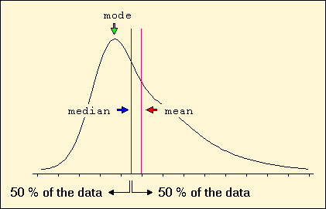
Measures of Central Tendency

Slide 45
Measures of Variability
Range
Range = Maximum – Minimum
Quantiles
The n^{th} percentile is the data value such that n percent of the data lies below that value
Variance and standard deviation
Both measure how far the data is spread from the mean
Larger values indicate data is more “spread out”
The standard deviation is the square root of the variance and has the same units as the data

Slide 46
Histogram
Shows distributional shape, range
X axis shows the values in the dataset, y axis shows relative frequency or percentage

Slide 47
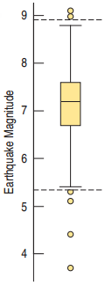
Box Plot
The box is the interquartile range
First quartile = 25th percentile
Third quartile = 75th percentile
The line inside the box is the median, or 50th percentile
Above and below the box are whiskers that show the most extreme data values within the “fences”
Outliers are data values outside the fences

Slide 48
Class Exercise #5
Get familiar with the trees dataset
?trees
Run nrow(), ncol(), str(), head(), tail()
Generate descriptive statistics using summary()
Plot the distributions of the variables using hist() and boxplot()

Slide 49
Bivariate Summaries
Generating descriptive statistics for one variable at different values of a second variable
Allows you to see if distributional characteristics depend on a second variable

Slide 50
Bivariate Tables
table(var1, var2)
Frequencies
Var1 is row variable, var2 is column variable
prop.table(table(var1, var2), k))
Proportions instead of frequencies
k=1 to sum by row, k=2 to sum by column

Slide 51
Summary Statistics
The aggregate() function computes summary statistics for a given combination of variables
Syntax:
aggregate(var1 ~ var2, df, type, na.action=na.omit)
var1: the variable you want to summarize
var2: the subgroup variable
df: dataframe containing the variables
type: summary statistic (e.g. mean)
na.action=na.omit ignores missing observations

Slide 52
Box Plots
Side-by-side box plots allow you to visually compare the distributional characteristics for different levels of a categorical variable
Boxplot(var1 ~ var2, df)
Boxplots of var1 as a function of var2
df identifies the dataset containing the variables

Slide 53
Class Exercise #6
Get familiar with the iris dataset
Calculate mean sepal length, sepal width, petal length, and petal width for each species
Generate side-by-side box plots that show the distributional characteristics of each of these variables by species

Slide 54
Data Visualization

Slide 55
Graphics in R
There are three mechanisms for generating graphics in R
base plotting system
ggplot2 (future lectures)
lattice graphics
For any given plot, there are likely several different ways to generate it

Slide 56
Basic Plotting Syntax
plot() function
Specify:
x and y variables, may use formula notation
type of plot (points, lines, both, step function, …)
Point type/size (if scatter plot)
line type/width (if line plot)
x and y axis scaling
titles and axis labels
colors

Slide 57
Basic Plotting Syntax
Graphical parameters
pch: the plotting symbol (default is open circle)
cex: size of plotting symbol (scaled relative to default)
lty: line type (default is solid line)
lwd: line width (specified as integer multiple)
col: plotting color
xlim, ylim: axis limits
xlab, ylab: axis labels

Slide 58
Scatterplot Example
First generate some data:
The resulting data:
Note: new functions
seq() generates a sequence
sample() draws a random sample
a <- seq(1:100) + 0.1*seq(1:100)*sample(c(1:10) , 100 , replace=TRUE)
b <- seq(1:100) + 0.2*seq(1:100)*sample(c(1:10) , 100 , replace=TRUE)
1.2 3.4 5.1 6.8 9.5 10.2 7.7 10.4 15.3 16.0
1.2 4.4 4.8 6.4 7.0 10.8 9.8 11.2 18.0 12.0

Slide 59
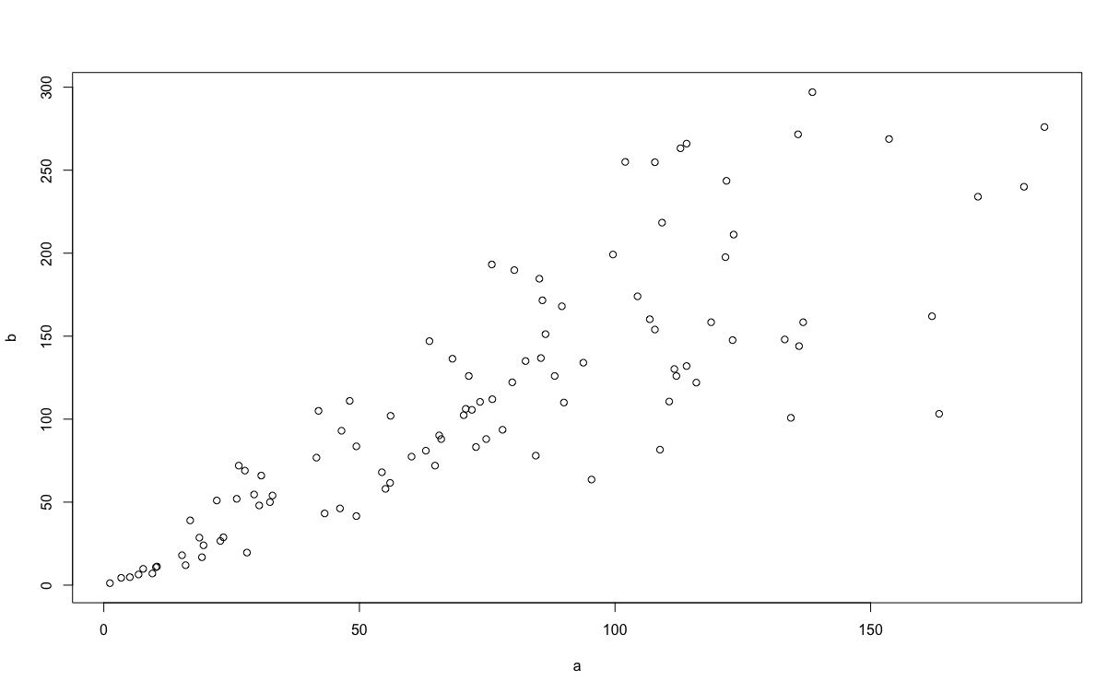
Scatterplot Example
plot(a, b)

Slide 60
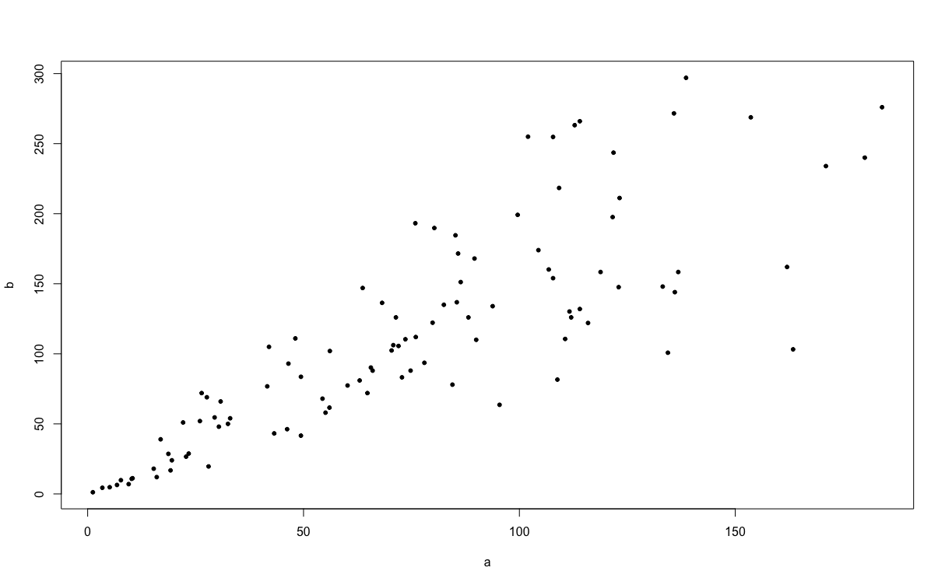
Scatterplot Example
plot(a, b, pch=20)

Slide 61
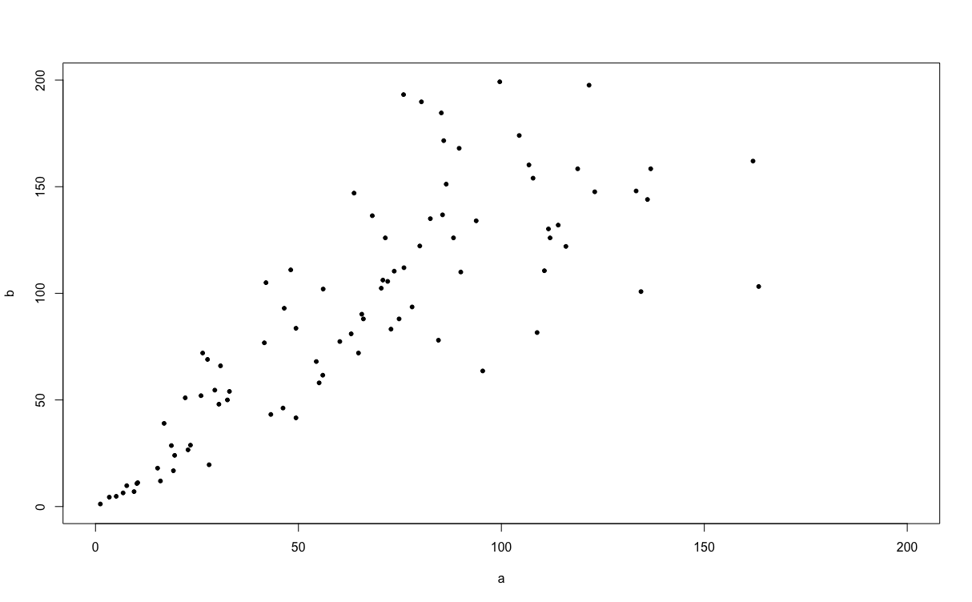
Scatterplot Example
plot(a, b, pch=20, xlim=c(0,200), ylim=c(0,200))

Slide 62
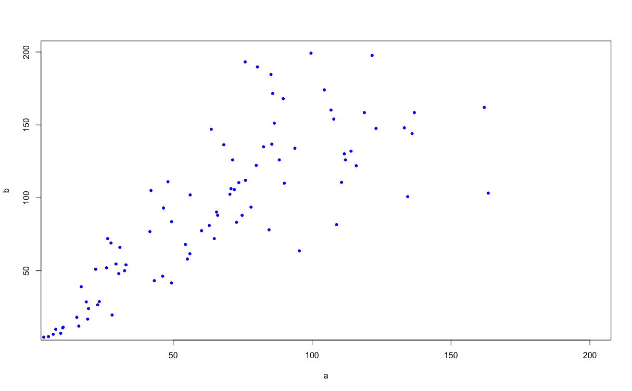
Scatterplot Example
plot(a, b, xlim=c(10,200), ylim=c(10,200), pch=20, col="blue")

Slide 63
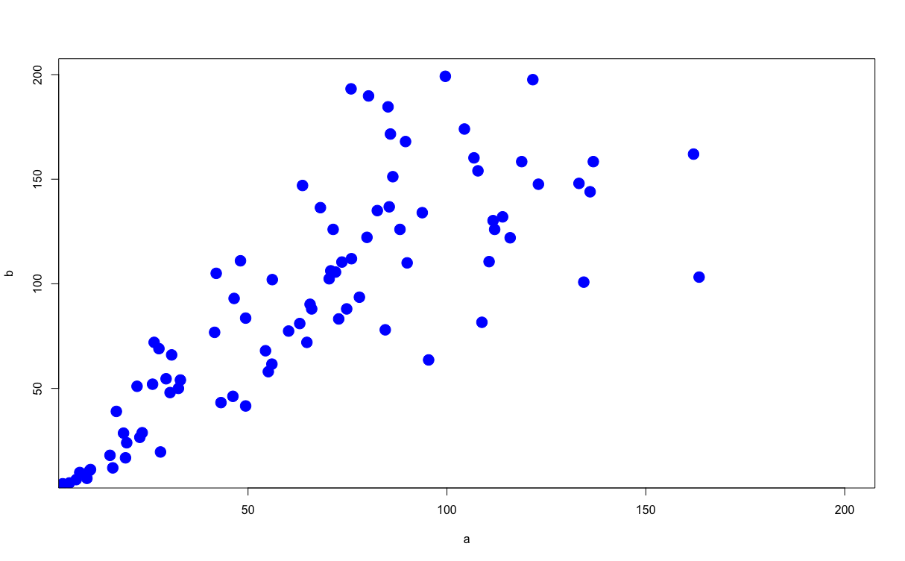
Scatterplot Example
plot(a, b, xlim=c(10,200), ylim=c(10,200), pch=20, col="blue", cex=3)

Slide 64
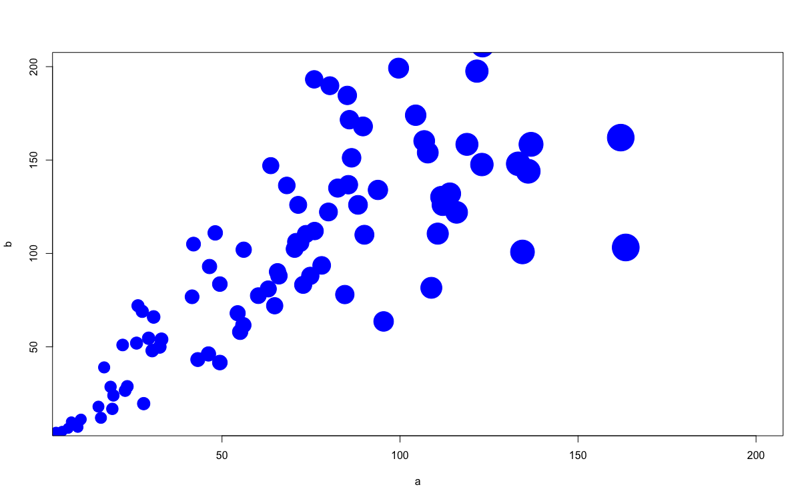
Scatterplot Example
plot(a, b, xlim=c(10,200), ylim=c(10,200), pch=20, col="blue", cex=3+(a/30))

Slide 65
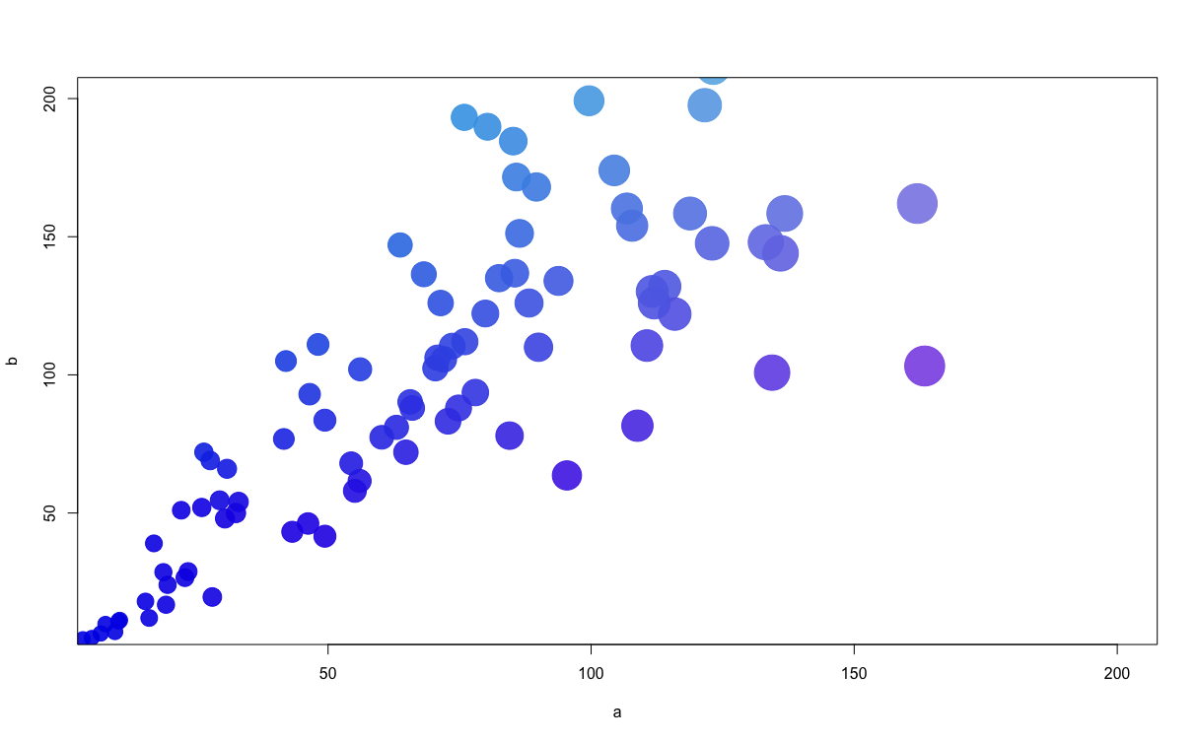
Scatterplot Example
plot(a, b, xlim=c(10,200), ylim=c(10,200), pch=20, cex=3+(a/30) , col=rgb(a/300,b/300,0.9,0.9) )

Slide 66
Axis Labels
xlab=“X axis label”, ylab=“Y axis label” added to string of plot commands in plot() function
Plot(x, y, …. , ylab=“blah”, ylab=“blah”)

Slide 67
Class Exercise #7
Use the iris dataset
Create the following scatter plot
Sepal width (y) vs. sepal length (x)
Points color-coded by species
Points are solid dots (pch=20, cex=2)
X axis ranges from 4 to 8, y axis from 2 to 4
Add axis labels

Slide 68
Adding a Legend
legend(x, y, pch=??, cex=??, c(“val1”,”val2”,”val3”), col=c(“col1”,”col2”,”col3”)
Where:
x and y are coordinates where the legend is to be placed
pch and cex are character and size
col1/val1 is the color corresponding to each value of the variable

Slide 69
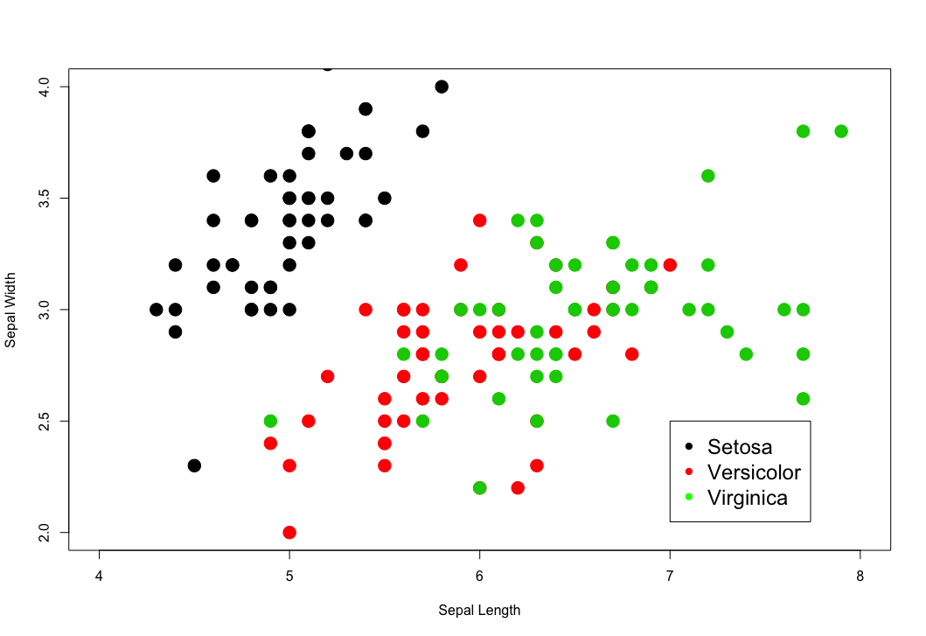
Adding a Legend
plot(iris$Sepal.Length, iris$Sepal.Width, xlim=c(4, 8), ylim=c(2, 4),pch=20, cex=3, col=iris$Species)
legend(7, 2.5, pch=20, cex=1.5, c("Setosa", "Versicolor", "Virginica"), col=c("black", "red", "green"))

Slide 70
Line Graph
Within the plot() command, specify type=“l” to get a line graph
Other useful parameters for line graphs:
lty: line type
lty=1 (solid), lty=2 (dashed), lty=3 (dotted) etc.
lwd: line width
lwd=integer; lwd=1 is default width

Slide 71
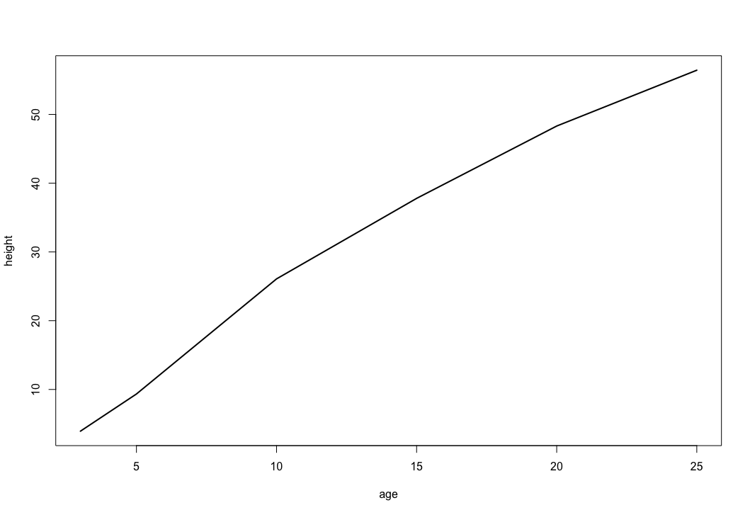
Line Graph
plot(height ~ age, data=Loblolly, type="l", lwd=2, subset = Seed == 329)

Slide 72
Lattice Graphics
Lattice graphics create a matrix of plots to show how bivariate relationships differ by levels of a third variable
E.g, how does the relationship between fuel efficiency (mpg) and number of cylinders vary by transmission type (automatic vs. manual)?

Slide 73
Lattice Graphics
Lattice package
Not part of basic installation
Needs to be loaded before use using the library() function:
xyplot() function:
library(lattice)
xyplot(y ~ x | group, data=df, ...)

Slide 74
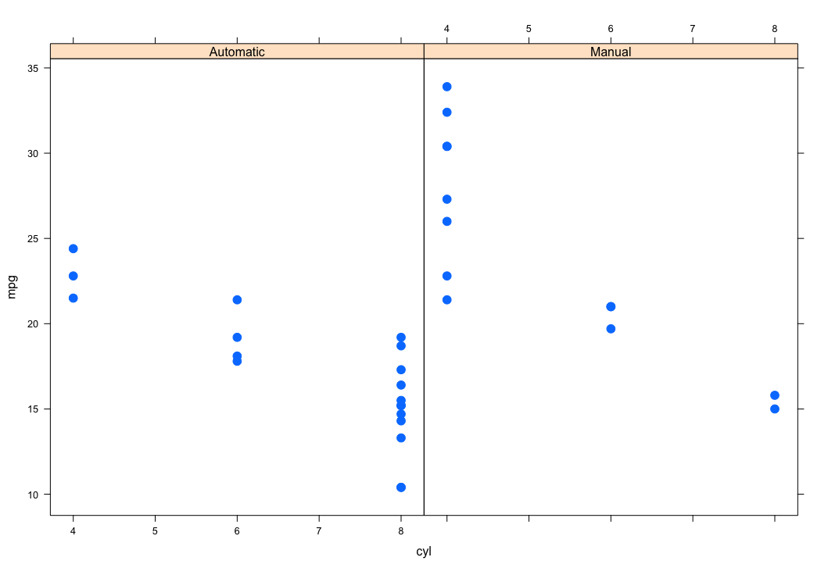
Lattice Graphics
xyplot(mpg ~ cyl | transmission, data=newdata, pch=20, cex=2)

Slide 75
Class Exercise #8
Use the iris dataset
Create a lattice plot that shows how the relationship between sepal length and sepal width varies by species

Slide 76
Bar Chart
Tabulate categorical variables using table()
frequencies
proportions
Function barplot() turns the resulting table into a bar chart

Slide 77
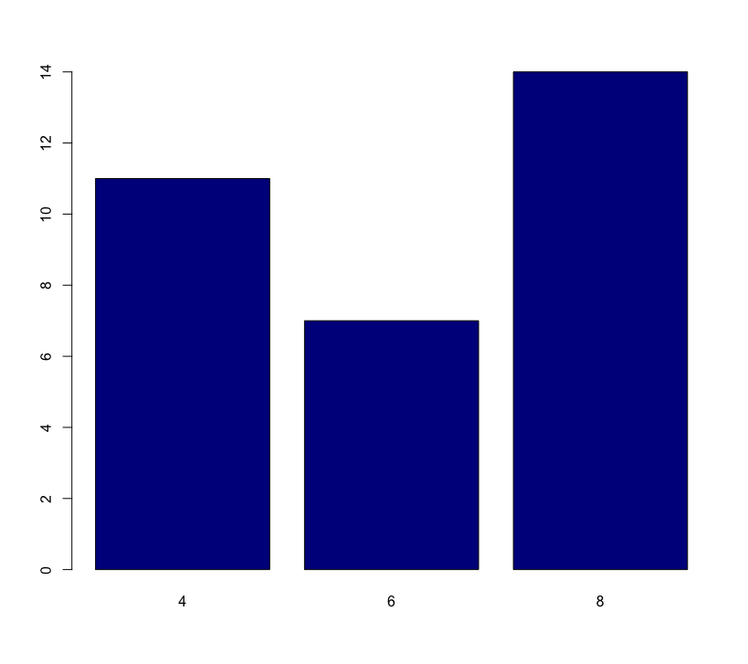
Plain Bar Chart
counts <- table(newdata$cyl)
barplot(counts, col="darkblue")

Slide 78
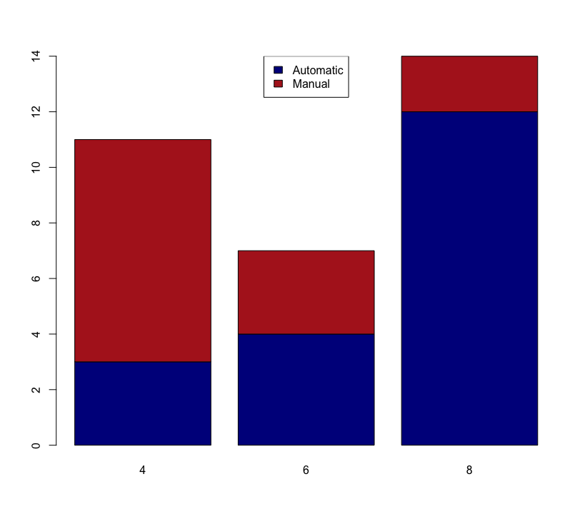
Stacked Bar Chart
counts <- table(newdata$transmission, newdata$cyl)
barplot(counts, col=c("darkblue", "firebrick"))
legend("top", legend=rownames(counts), fill=c("darkblue", "firebrick"))

Slide 79
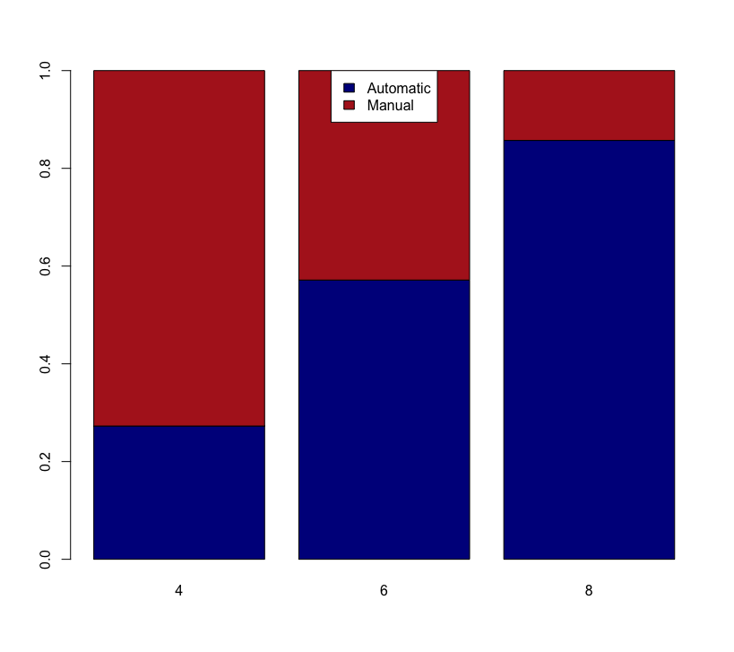
Proportional Stacked Bar Chart
counts <- prop.table(table(newdata$transmission, newdata$cyl), 2)
barplot(counts, col=c("darkblue", "firebrick"))
legend("top", legend=rownames(counts), fill=c("darkblue", "firebrick"))

Slide 80
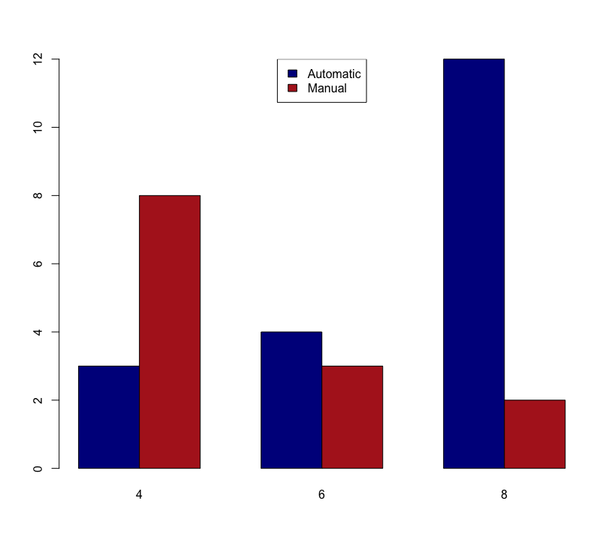
Grouped Bar Chart
counts <- table(newdata$transmission, newdata$cyl)
barplot(counts, col=c("darkblue", "firebrick"), beside=TRUE)
legend("top", legend=rownames(counts), fill=c("darkblue", "firebrick"))

